Slide 1
Training for Clinical Study

Slide 2
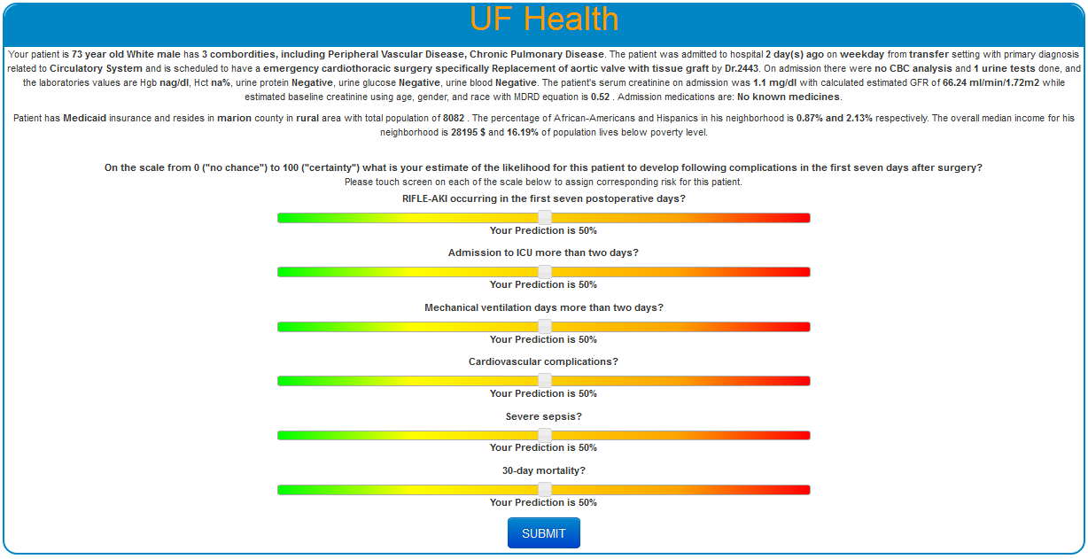
First Evaluation
The Patients Story
Criteria to Evaluate Patient
A slide scale to input
Expected Risk

Slide 3
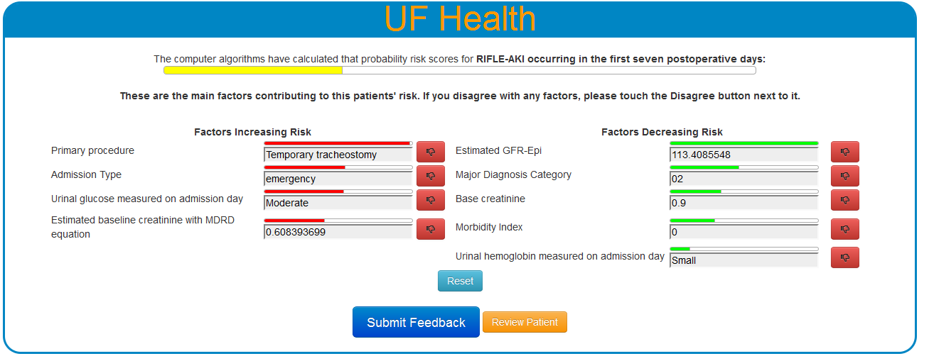
Risk Evaluation
Machines Prediction
Reset Selections
Go to next Screen
Review the Story

Slide 4
Risk Evaluation
Reject Risk
Contribution of factor, relative to given 10.

Slide 5
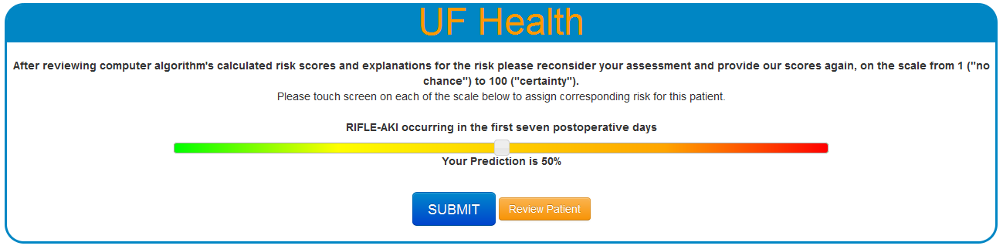
Review Evaluation
Risk to review
Slide to Predict
Review the Patient

Slide 6
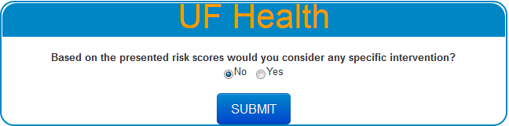
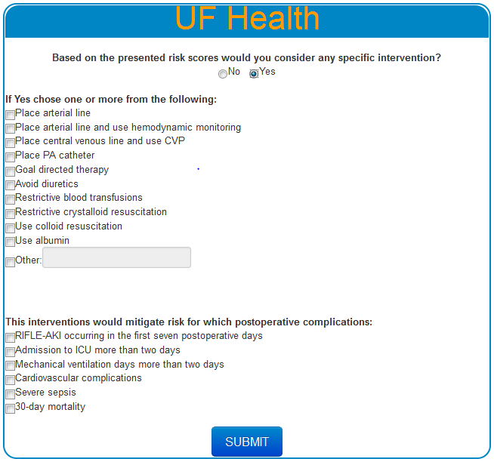
Recommendation Systems

